Slide 1
Artificial Neural Networks (ANNs)

Slide 2
What are Artificial Neural Networks (ANNs)?
“……..a computing system made up of a number of simple, highly interconnected processing elements, which process information by their dynamic state response to external inputs.”
The term "Artificial Neural Network" is derived from Biological neural networks that develop the structure of a human brain. Similar to the human brain that has neurons interconnected to one another, artificial neural networks also have neurons that are interconnected to one another in various layers of the networks. These neurons are known as nodes.
Dendrites from Biological Neural Network represent inputs in Artificial Neural Networks, cell nucleus represents Nodes, synapse represents Weights, and Axon represents Output.

Slide 3
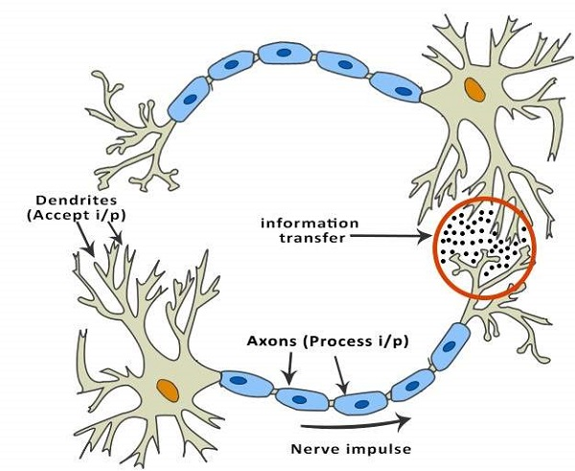
ANNs are composed of multiple nodes, which imitate biological neurons of human brain. The neurons are connected by links and they interact with each other. The nodes can take input data and perform simple operations on the data. The result of these operations is passed to other neurons. The output at each node is called its activation or node value.
Each link is associated with weight. ANNs are capable of learning, which takes place by altering weight values.

Slide 4
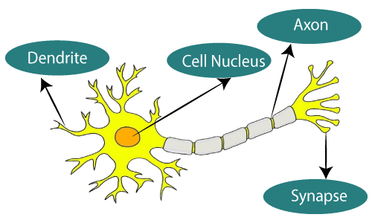
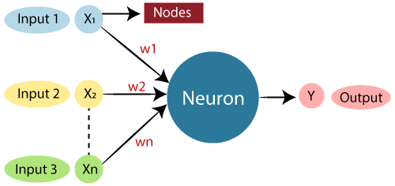

Slide 5
The architecture of an artificial neural network:
To understand the concept of the architecture of an artificial neural network, we have to understand what a neural network consists of. In order to define a neural network that consists of a large number of artificial neurons, which are termed units arranged in a sequence of layers. Lets us look at various types of layers available in an artificial neural network.
Input Layer:
As the name suggests, it accepts inputs in several different formats provided by the programmer.
Hidden Layer:
The hidden layer presents in-between input and output layers. It performs all the calculations to find hidden features and patterns.
Output Layer:
The input goes through a series of transformations using the hidden layer, which finally results in output that is conveyed using this layer.

Slide 6
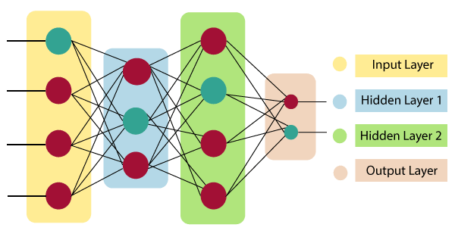
The artificial neural network takes input and computes the weighted sum of the inputs and includes a bias. This computation is represented in the form of a transfer function.

Slide 7
Advantages of Artificial Neural Network (ANN)
Parallel processing capability:
Artificial neural networks have a numerical value that can perform more than one task simultaneously.
Storing data on the entire network:
Data that is used in traditional programming is stored on the whole network, not on a database. The disappearance of a couple of pieces of data in one place doesn't prevent the network from working.
Capability to work with incomplete knowledge:
After ANN training, the information may produce output even with inadequate data. The loss of performance here relies upon the significance of missing data.
Having a memory distribution:
For ANN is to be able to adapt, it is important to determine the examples and to encourage the network according to the desired output by demonstrating these examples to the network. The succession of the network is directly proportional to the chosen instances, and if the event can't appear to the network in all its aspects, it can produce false output.
Having fault tolerance:
Extortion of one or more cells of ANN does not prohibit it from generating output, and this feature makes the network fault-tolerance.

Slide 8
Disadvantages of Artificial Neural Network:
Assurance of proper network structure:
There is no particular guideline for determining the structure of artificial neural networks. The appropriate network structure is accomplished through experience, trial, and error.
Unrecognized behavior of the network:
It is the most significant issue of ANN. When ANN produces a testing solution, it does not provide insight concerning why and how. It decreases trust in the network.
Hardware dependence:
Artificial neural networks need processors with parallel processing power, as per their structure. Therefore, the realization of the equipment is dependent.
Difficulty of showing the issue to the network:
ANNs can work with numerical data. Problems must be converted into numerical values before being introduced to ANN. The presentation mechanism to be resolved here will directly impact the performance of the network. It relies on the user's abilities.
The duration of the network is unknown:
The network is reduced to a specific value of the error, and this value does not give us optimum results.

Slide 9
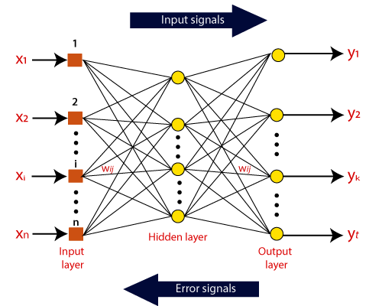
How do artificial neural networks work?
Artificial Neural Network can be best represented as a weighted directed graph, where the artificial neurons form the nodes. The association between the neurons outputs and neuron inputs can be viewed as the directed edges with weights. The Artificial Neural Network receives the input signal from the external source in the form of a pattern and image in the form of a vector. These inputs are then mathematically assigned by the notations x(n) for every n number of inputs.

Slide 11
Afterward, each of the input is multiplied by its corresponding weights ( these weights are the details utilized by the artificial neural networks to solve a specific problem ). In general terms, these weights normally represent the strength of the interconnection between neurons inside the artificial neural network. All the weighted inputs are summarized inside the computing unit.
If the weighted sum is equal to zero, then bias is added to make the output non-zero or something else to scale up to the system's response. Bias has the same input, and weight equals to 1. Here the total of weighted inputs can be in the range of 0 to positive infinity. Here, to keep the response in the limits of the desired value, a certain maximum value is benchmarked, and the total of weighted inputs is passed through the activation function.
The activation function refers to the set of transfer functions used to achieve the desired output. There is a different kind of the activation function, but primarily either linear or non-linear sets of functions. Some of the commonly used sets of activation functions are the Binary, linear, and Tan hyperbolic sigmoidal activation functions.

Slide 12
Types of Artificial Neural Network:
Feedback ANN:
In this type of ANN, the output returns into the network to accomplish the best-evolved results internally. As per the University of Massachusetts, Lowell Centre for Atmospheric Research. The feedback networks feed information back into itself and are well suited to solve optimization issues. The Internal system error corrections utilize feedback ANNs.
Feed-Forward ANN:
A feed-forward network is a basic neural network comprising of an input layer, an output layer, and at least one layer of a neuron. Through assessment of its output by reviewing its input, the intensity of the network can be noticed based on group behavior of the associated neurons, and the output is decided. The primary advantage of this network is that it figures out how to evaluate and recognize input patterns.

Slide 13
There is no control unit to monitor the information being processed into the network.
1.It is short for Artificial Neural Network.
2.Processing speed is fast as compared to Biological Neural Network.
3.Allocation for Storage to a new process is strictly irreplaceable as the old location is saved for the previous process.
4.Processes operate in sequential mode.
5.If any information gets corrupted in the memory it cannot be retrieved.
6.The activities are continuously monitored by a control unit.
1. It is short for Biological Neural Network.
2. They are slow in processing information.
3. Allocation for storage to a new process is easy as it is added just by adjusting the interconnection strengths.
4. The process can operate in massive parallel operations.
5. Information is distributed into the network throughout into sub-nodes, even if it gets corrupted it can be retrieved.
6. There is no control unit to monitor the information being processed into the network.

Slide 14
Types of Artificial Intelligence Learning
Learning is one of the fundamental building blocks of artificial intelligence (AI) solutions. From a conceptual standpoint, learning is a process that improves the knowledge of an AI program by making observations about its environment.
To understand the different types of AI learning models, we can use two of the main elements of human learning processes: knowledge and feedback

Slide 15
AI Learning Models: Knowledge-Based Classification
Factoring its representation of knowledge, AI learning models can be classified in two main types: inductive and deductive.
— Inductive Learning: This type of AI learning model is based on inferring a general rule from datasets of input-output pairs.. Algorithms such as knowledge based inductive learning(KBIL) are a great example of this type of AI learning technique. KBIL focused on finding inductive hypotheses on a dataset with the help of background information.
— Deductive Learning: This type of AI learning technique starts with the series of rules and infers new rules that are more efficient in the context of a specific AI algorithm. Explanation-Based Learning(EBL) and Relevance-0Based Learning(RBL) are examples of deductive techniques. EBL extracts general rules from examples by “generalizing” the explanation. RBL focuses on identifying attributes and deductive generalizations from simple example.

Slide 16
AI Learning Models: Feedback-Based Classification
Based on the feedback characteristics, AI learning models can be classified as supervised, unsupervised, semi-supervised or reinforced.
— Unsupervised Learning: Unsupervised models focus on learning a pattern in the input data without any external feedback. Clustering is a classic example of unsupervised learning models.
— Supervised Learning: Supervised learning models use external feedback to learning functions that map inputs to output observations. In those models the external environment acts as a “teacher” of the AI algorithms.
— Semi-supervised Learning: Semi-Supervised learning uses a set of curate, labeled data and tries to infer new labels/attributes on new data sets. Semi-Supervised learning models are a solid middle ground between supervised and unsupervised models.
— Reinforcement Learning: Reinforcement learning models use opposite dynamics such as rewards and punishment to “reinforce” different types of knowledge. This type of learning technique is becoming really popular in modern AI solutions.

